Slide 1
Big Data in Finance
Big Data in Finance
04/03/2021
Predicting daily, stock-level returns
Ahamad Hussein Ismail

Slide 2
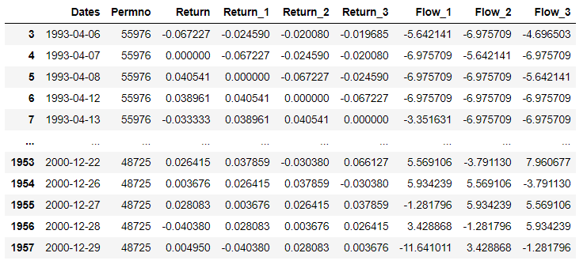
Data cleaning
Big Data in Finance
04/03/2021
Created an empty dataframe with columns Dates, Permno, Returns, and Returns/Flows number of lags
Stacked each stock underneath one another based on their Permno and Dates and put it into the empty data dataframe
Concatenated all dataframes with different stocks into one dataframe
Lagged the returns and flows based on each stock individually
Cleaned data frame used for warm-up exercise

Slide 3
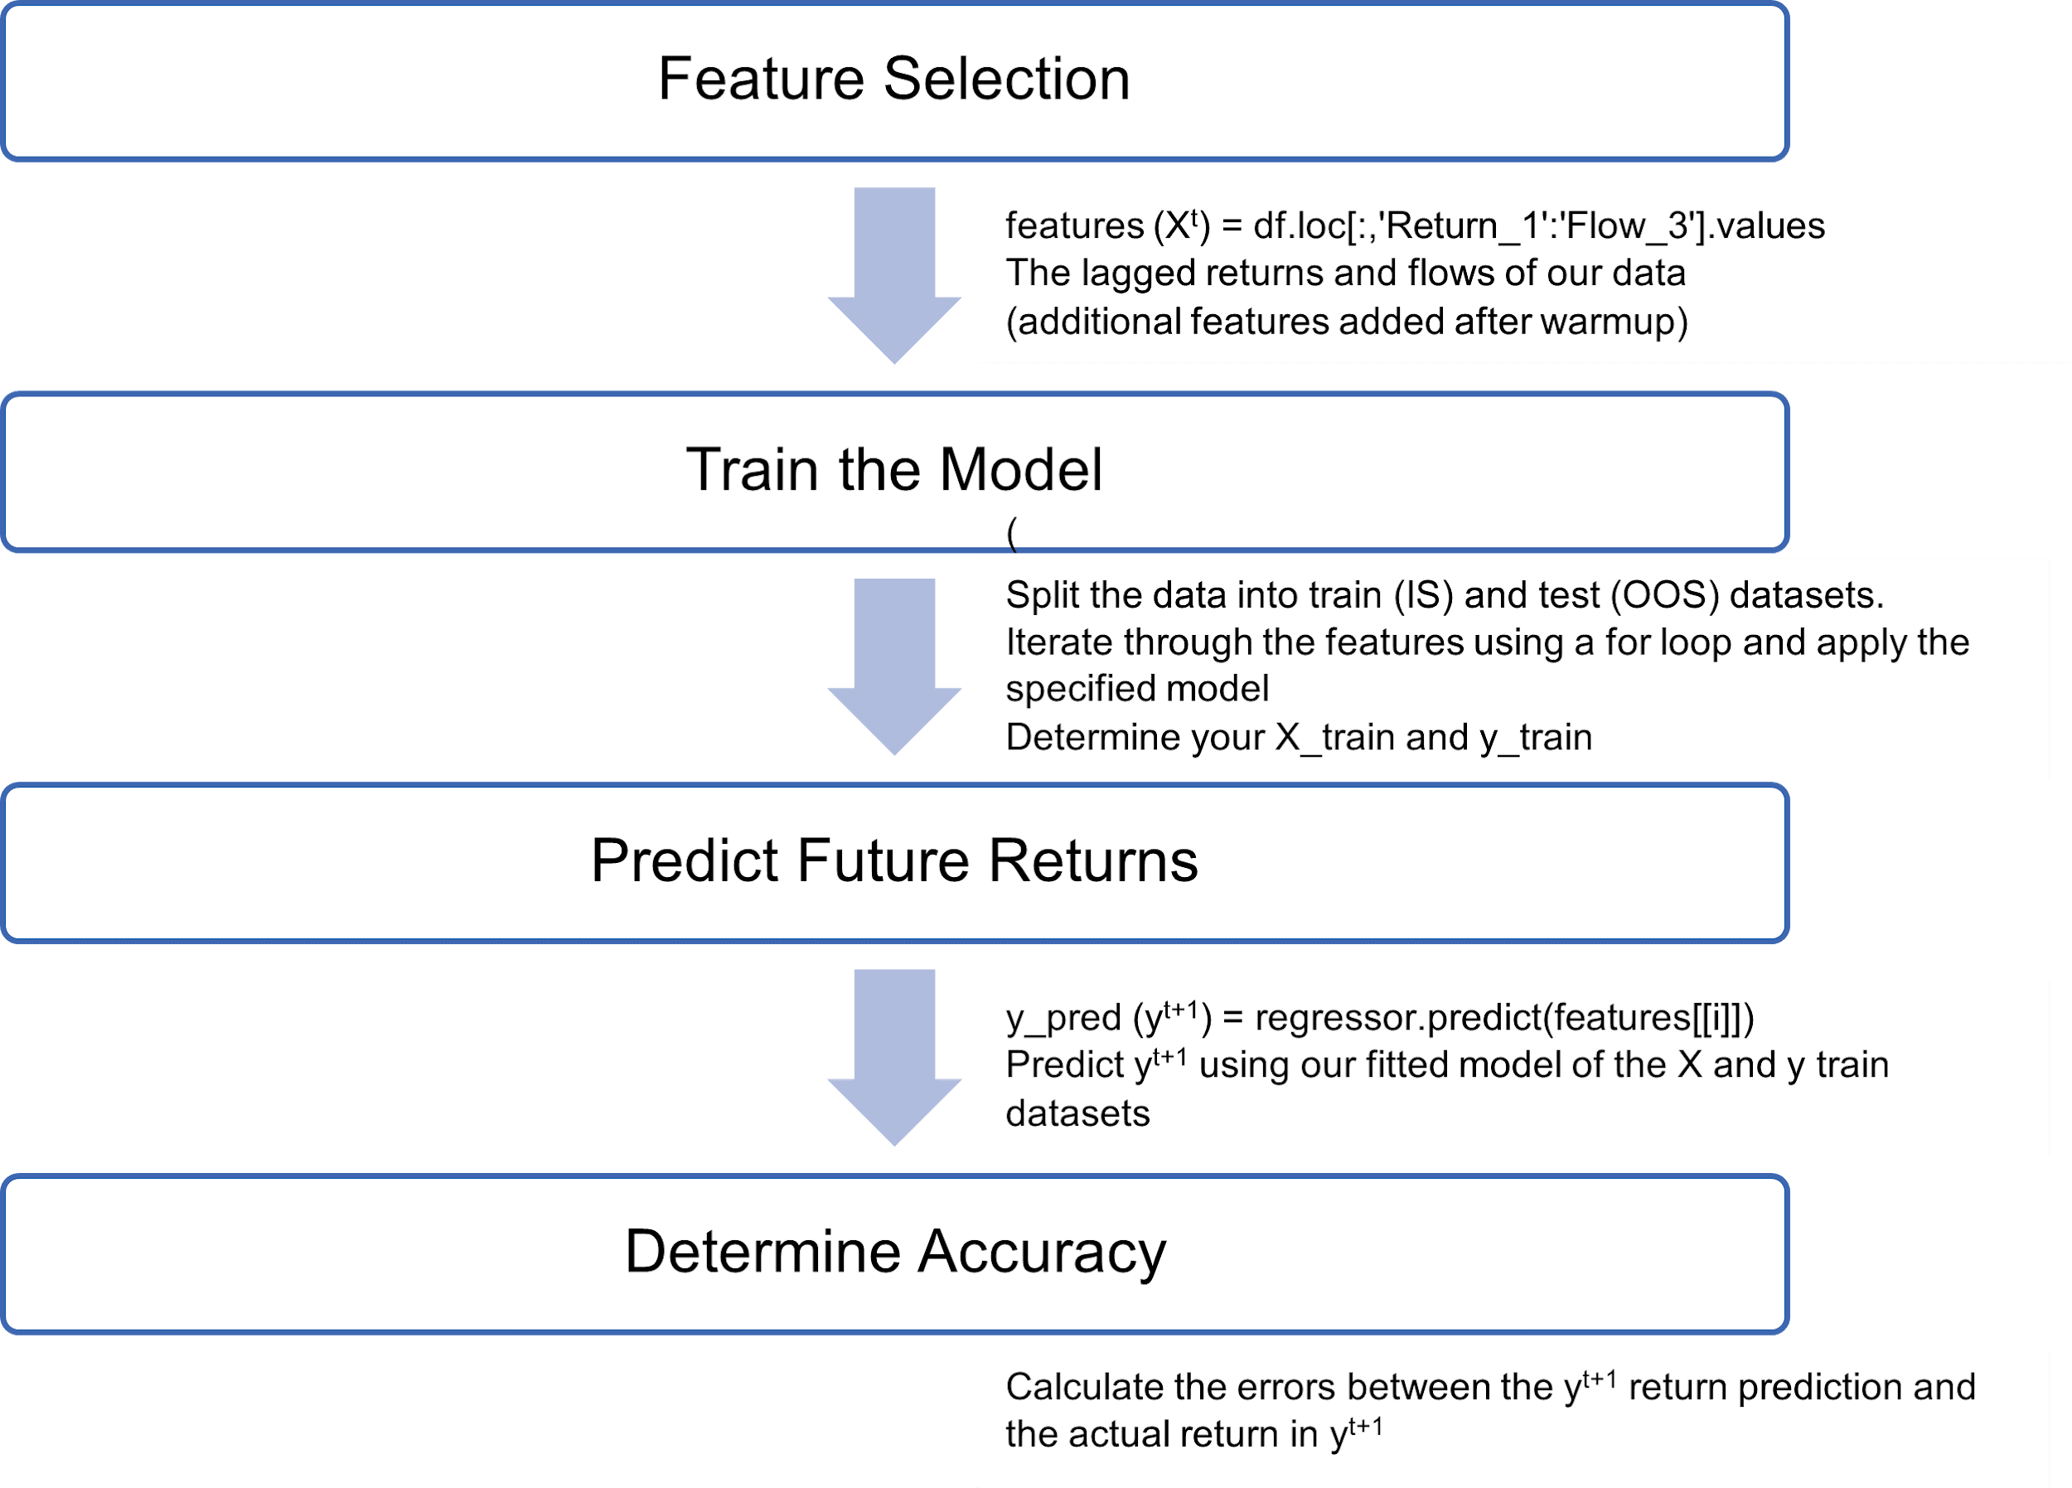
Warmup and General Procedure
Big Data in Finance
04/03/2021
Defined a function with inputs stocks, window size, and model
Linear model run with varying rolling window sizes, final rolling window size = 252 selected (trading days in a year)
Historical mean model outperforms the linear regression model for smaller window sizes with the outperformance decreasing the larger the window size gets
With large enough window sizes, the linear regression model begins to outperform the historical mean model
General flow diagram for the models used

Slide 4
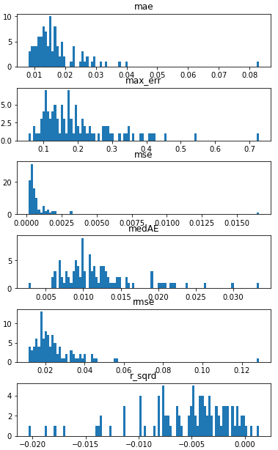
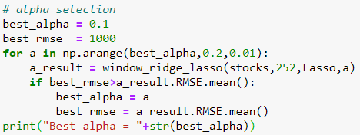
LASSO
Big Data in Finance
04/03/2021
Features added: Mrkt_min_return/flow, Mrkt_max_return/flow, Mrkt_mean_return/flow, Mrkt_median_return/flow
Alpha selection: 0.1
Error metrics for the LASSO regression

Slide 5
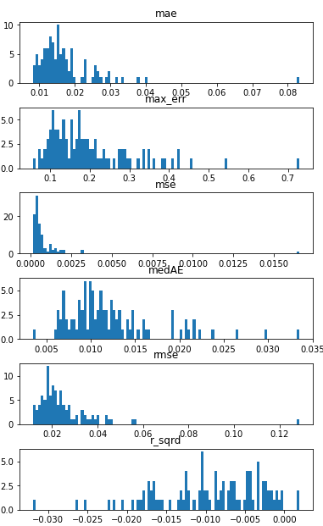
Ridge
Big Data in Finance
04/03/2021
Same features used as in LASSO
Alpha selection: 991 Alpha selected using the same for loop as in the previous slide
LASSO R² and RMSE: 3 models with an R² above 0, RMSE distribution mainly around 0.02
Ridge R² and RMSE: 1 model with an R² above 0, RMSE distribution mainly around 0.02
Error metrics for the Ridge regression

Slide 6
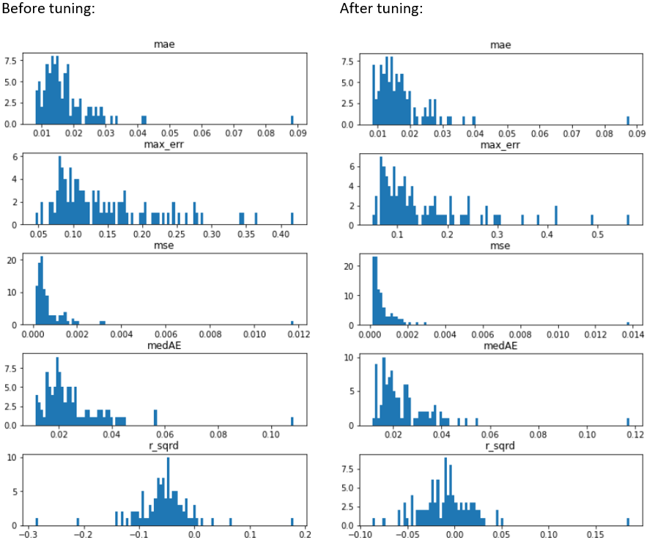
Random Forest Regression
Big Data in Finance
04/03/2021
Same features used as in LASSO
Hyperparameter tuning, best parameters: n_estimators: 1200, min_samples_split: 5, min_samples_leaf: 2, max_features: sqr, max_depth: 10
After tuning distribution of R² increases
Error metrics for the Random Forest regression before and after tuning

Slide 7
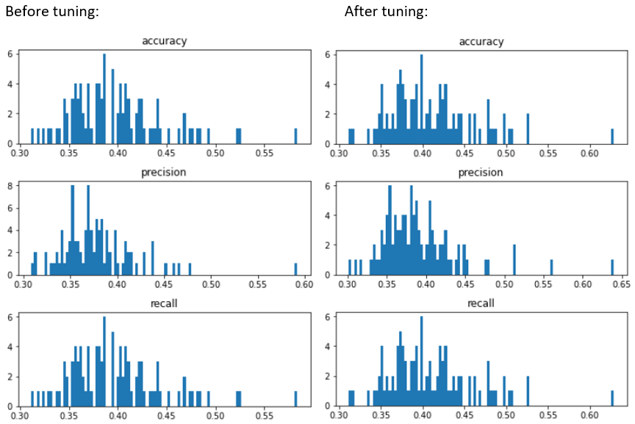
Random Forest Classification
Big Data in Finance
04/03/2021
Dataset: lagged returns, lagged flows, lagged tertiles to t-7, tertile high and tertile low.
RF classification seems to be more useful than RF regression in predicting stock returns
The number of false outperformers and underperformers was very low.
Performance metrics for the Random Forest classification before and after tuning

Slide 8
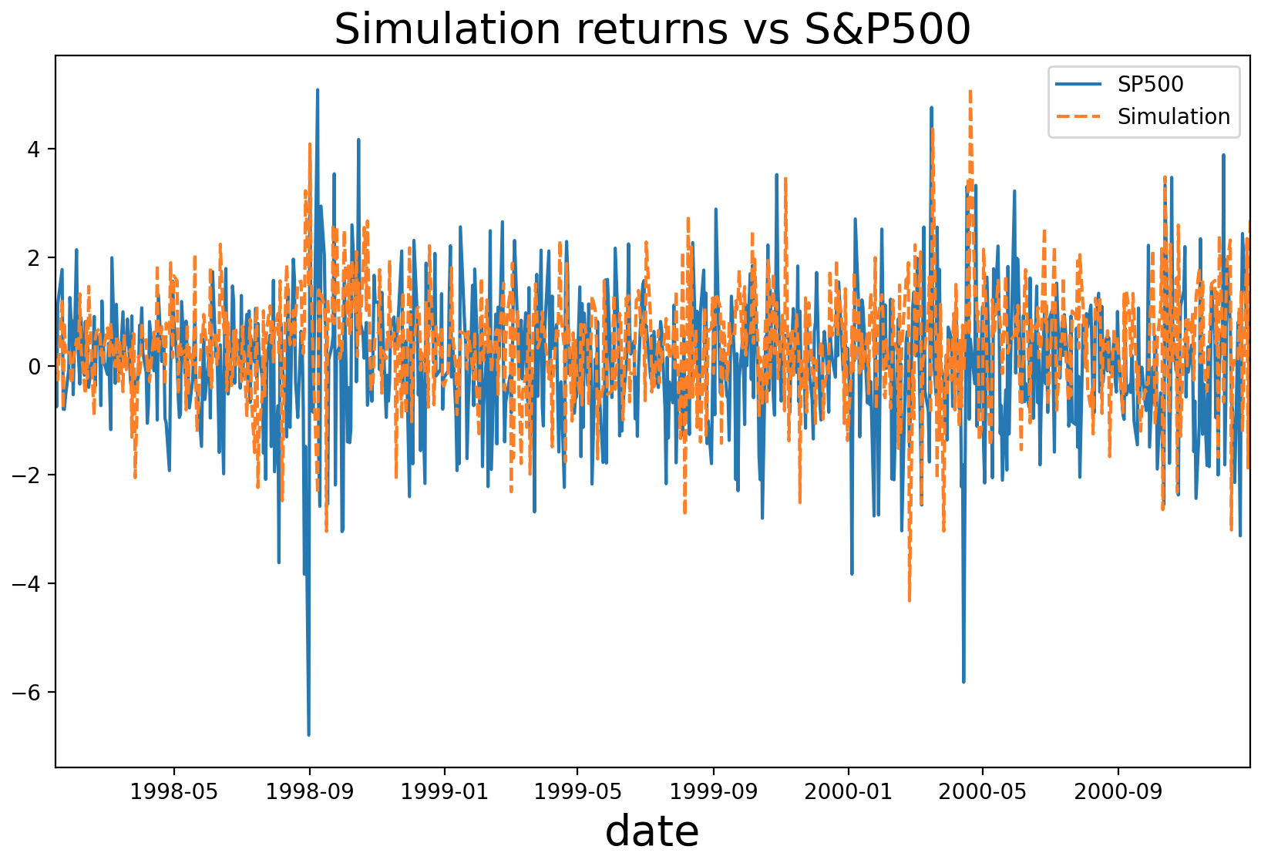
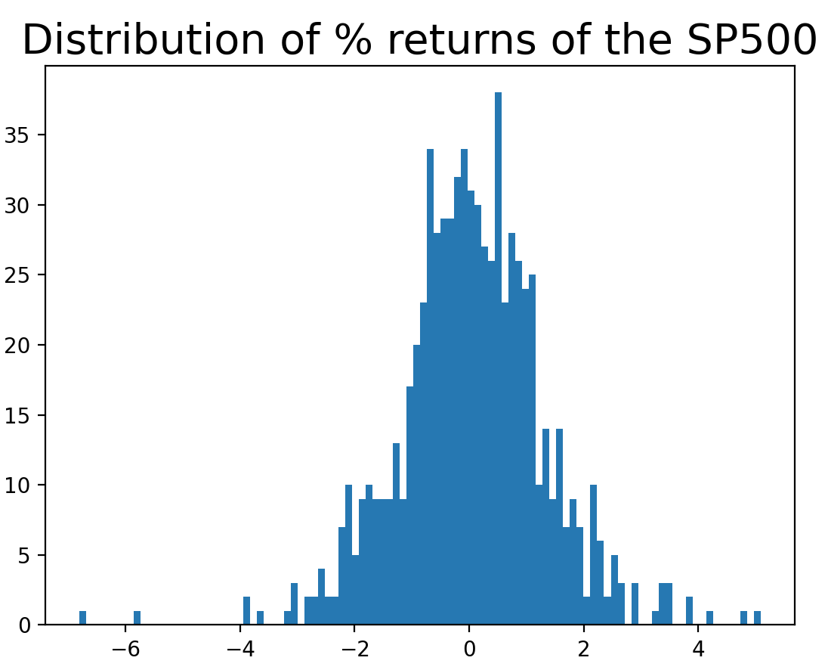
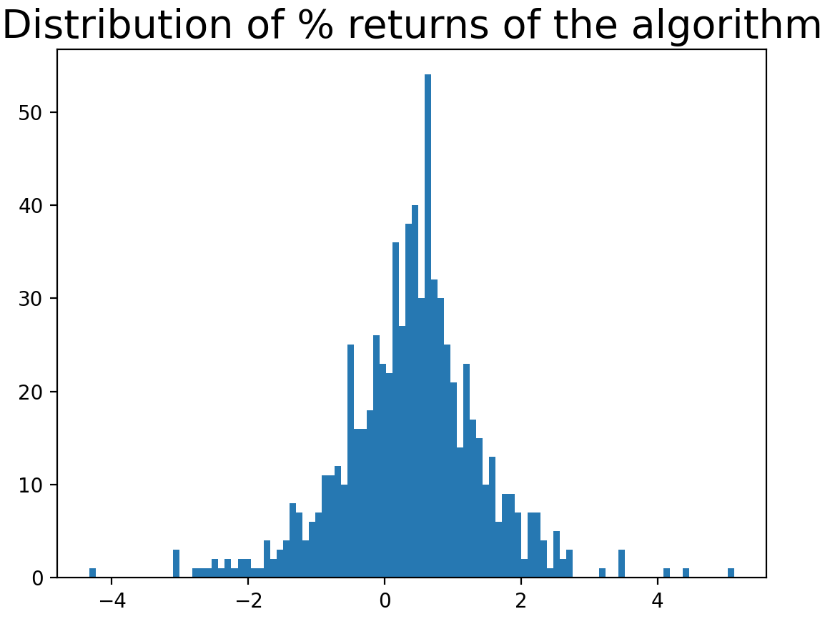
Trading Simulation: Model vs S&P 500
Big Data in Finance
04/03/2021
Train models
For every day of the trading period:
Predict tertile of each stock.
Open 5 long and 5 short positions with 10% allocation.
Calculate returns
Compare daily returns for the period with daily S&P 500.

Slide 9
Evaluation of the Models
Big Data in Finance
04/03/2021
Random forest has the highest accuracy, beating the historical mean
Classification improves the random forest result
Large window sizes can improve model accuracy (8 to 12 quarters)
Increased model accuracy comes with lengthier computation time -> double-edged sword
 | Accuracy (mean rmse)
Linear regression | 0.025136
Historical mean | 0.024894
Ridge | 0.025062
LASSO | 0.024897
Tuned RF regression | 0.024452

